Slide 1
Web Programming
Chapter Three
Files and Directories

Slide 2
PHP Manipulating Files
PHP has several functions for creating, reading, writing, and editing files.
When manipulating files, you must be very careful, as mistakes can cause significant damage.
Common errors include
Editing or deleting the wrong file.
Overwriting important data unintentionally.

Slide 3
PHP Manipulating Files...
Filling the hard drive with excessive data.
Failing to close file handles, leading to memory leaks.
Incorrect file permissions, causing security vulnerabilities.
Handling concurrent file access improperly, leading to race conditions.
Not handling errors properly, resulting in script crashes or unexpected behavior.

Slide 4
PHP readfile() Function
The readfile() function reads a file and writes its contents to the output buffer.
How it works
Assume we have a text file called "webdictionary.txt" stored on the server, containing the following content
AJAX = Asynchronous JavaScript and XML
CSS = Cascading Style Sheets
HTML = HyperText Markup Language
PHP = PHP Hypertext Preprocessor

Slide 5
PHP readfile() Function...
The following PHP code reads the file and writes its contents to the output buffer.
The readfile() function returns the number of bytes read on success
Basic Syntax:
<?php
echo readfile("webdictionary.txt");
?>
The readfile() function is useful when you only need to open a file and read its contents without additional processing.

Slide 6
PHP readfile() Function...
Handling Errors
By default, readfile() will generate warnings if the file does not exist. You can prevent this by using proper error handling:
<?php
$filename = "webdictionary.txt";
if (file_exists($filename))
{
echo readfile($filename);
} else {
echo "Error: File not found!";
}
?>

Slide 7
PHP readfile() Function...
Using readfile() for File Downloads
You can use readfile() to force a file download instead of displaying it in the browser:
<?php
$file = "example.pdf";
if (file_exists($file)) {
header('Content-Description: File Transfer');
header('Content-Type: application/octet-stream');
header('Content-Disposition: attachment; filename="'.basename($file).'"');
header('Content-Length: ' . filesize($file));
readfile($file);
exit;
} else {
echo "File not found."; }
?>

Slide 8
PHP readfile() Function...
Explanation:
header('Content-Disposition: attachment; filename="..."') prompts the browser to download the file instead of displaying it.
header('Content-Length: ...') ensures the correct file size is sent.
exit; stops script execution after sending the file.
Performance Considerations
readfile() is more efficient for small to medium files because it does not require opening a file handle.
For large files, readfile() may consume too much memory. Using fopen() and fpassthru() is a better approach:

Slide 9
PHP File Open/Read/Close
PHP Open File - fopen()
A better method to open files is with the fopen() function.
This function gives you more options than the readfile() function.
We will use the text file, "webdictionary.txt", during the lessons:
AJAX = Asynchronous JavaScript and XML CSS = Cascading Style Sheets HTML = Hyper Text Markup Language PHP = PHP Hypertext Preprocessor

Slide 10
PHP File Open/Read/Close...
The first parameter of fopen() contains the name of the file to be opened
And the second parameter specifies in which mode the file should be opened.
The following example also generates a message if the fopen() function is unable to open the specified file:
Example :
<?php $myfile = fopen("webdictionary.txt", "r") or die("Unable to open file!"); echo fread($myfile,filesize("webdictionary.txt")); fclose($myfile); ?>

Slide 11
The file may be opened in one of the following modes:
Modes | Description
r | Open a file for read only. File pointer starts at the beginning of the file
w | Open a file for write only. Erases the contents of the file or creates a new file if it doesn't exist. File pointer starts at the beginning of the file
a | Open a file for write only. The existing data in file is preserved. File pointer starts at the end of the file. Creates a new file if the file doesn't exist
x | Creates a new file for write only. Returns FALSE and an error if file already exists

Slide 12
The file may be opened in one of the following modes...
Modes | Description
r+ | Open a file for read/write. File pointer starts at the beginning of the file
w+ | Open a file for read/write. Erases the contents of the file or creates a new file if it doesn't exist. File pointer starts at the beginning of the file
a+ | Open a file for read/write. The existing data in file is preserved. File pointer starts at the end of the file. Creates a new file if the file doesn't exist
x+ | Creates a new file for read/write. Returns FALSE and an error if file already exists

Slide 13
PHP Read File - fread()
The fread() function reads data from an open file.
The first parameter of fread() is a file handle obtained from fopen(), and the second parameter specifies the maximum number of bytes to read.
The following PHP code reads the "webdictionary.txt" file to the end:
<?php
$file = fopen("example.txt", "r"); // Open file for reading
echo fread($file, filesize("example.txt")); // Read entire file
fclose($file); // Close file after reading
?>

Slide 14
PHP Close File - fclose()
The fclose() function is used to close an open file.
Note: It's a good programming practice to close all files after you have finished with them.
You don't want an open file running around on your server taking up resources!
The fclose() requires the name of the file (or a variable that holds the filename) we want to close:
<?php
$myfile = fopen("webdictionary.txt", "r");
// some code to be executed....
fclose($myfile);
?>

Slide 15
PHP Read Single Line - fgets()
The fgets() function is used to read a single line from a file.
The example below outputs the first line of the "webdictionary.txt" file:
Example:
<?php
$myfile = fopen("webdictionary.txt", "r") or die("Unable to open file!");
echo fgets($myfile);
fclose($myfile);
?>
Note: After calling the fgets() function, the file pointer moves to the next line.

Slide 16
PHP Check End-Of-File - feof()
The feof() function checks if the "end-of-file" (EOF) has been reached.
The feof() function is useful for looping through data of unknown length.
The example below reads the "webdictionary.txt" file line by line, until end-of-file is reached:
Example 4:
<?php
$myfile = fopen("webdictionary.txt", "r") or die("Unable to open file!");
// Output one line until end-of-file
while(!feof($myfile)) {
echo fgets($myfile) . "<br>";
}
fclose($myfile);
?>

Slide 17
PHP Read Single Character - fgetc()
The fgetc() function is used to read a single character from a file.
The example below reads the "webdictionary.txt" file character by character, until end-of-file is reached:
Example 5:
<?php
$myfile = fopen("webdictionary.txt", "r") or die("Unable to open file!");
// Output one character until end-of-file
while(!feof($myfile)) {
echo fgetc($myfile);
}
fclose($myfile);
?>
Note: After a call to the fgetc() function, the file pointer moves to the next character.

Slide 18
PHP File Create/Write
PHP Create File - fopen()
The fopen() function is also used to create a file. Maybe a little confusing, but in PHP, a file is created using the same function used to open files.
If you use fopen() on a file that does not exist, it will create it, given that the file is opened for writing (w) or appending (a).
The example below creates a new file called "testfile.txt". The file will be created in the same directory where the PHP code resides:
Example
$myfile = fopen("testfile.txt", "w")

Slide 19
PHP Write to File - fwrite()
The fwrite() function is used to write to a file.
The first parameter of fwrite() contains the name of the file to write to and the second parameter is the string to be written.
The example below writes a couple of names into a new file called "newfile.txt":
Example 6:
<?php $myfile = fopen("newfile.txt", "w") or die("Unable to open file!"); $txt = "John Doe\n"; fwrite($myfile, $txt); $txt = "Jane Doe\n"; fwrite($myfile, $txt); fclose($myfile); ?>

Slide 20
fwrite() …Cont
Notice that we wrote to the file "newfile.txt" twice. Each time we wrote to the file we sent the string $txt that first contained "John Doe" and second contained "Jane Doe". After we finished writing, we closed the file using the fclose() function.
If we open the "newfile.txt" file it would look like this:
John Doe Jane Doe

Slide 21
PHP Overwriting
Now that "newfile.txt" contains some data we can show what happens when we open an existing file for writing. All the existing data will be ERASED and we start with an empty file. In the example below we open our existing file "newfile.txt", and write some new data into it:
Example 7:
<?php $myfile = fopen("newfile.txt", "w") or die("Unable to open file!"); $txt = "Mickey Mouse\n"; fwrite($myfile, $txt); $txt = "Minnie Mouse\n"; fwrite($myfile, $txt); fclose($myfile); ?>
If we now open the "newfile.txt" file, both John and Jane have vanished, and only the data we just wrote is present:
Mickey Mouse Minnie Mouse

Slide 22
Uploading File
Create The HTML Form
Next, create an HTML form that allow users to choose the image file they want to upload:
e.g. File.html
<!DOCTYPE html> <html> <body> <form action="upload.php" method="post" enctype="multipart/form-data"> Select image to upload: <input type="file" name="fileToUpload[]" id="fileToUpload"> <input type="submit" value="Upload Image" name="submit"> </form> </body> </html>

Slide 23
Create The Upload File PHP Script
The "upload.php" file contains the code for uploading a file:
<?php
$name = $_FILES['fileToUpload']['name'];
$temp_name=$_FILES['fileToUpload']['tmp_name'];
echo $name."<br/>";
echo $temp_name;
$location='uploads/';
/*The move_uploaded_file() function moves an uploaded file to a new location*/
move_uploaded_file($temp_name,$location.$name);
echo “the image is successfully uploaded”; ?>

Slide 24
Check if File Already Exists
Now we can add some restrictions.
First, we will check if the file already exists in the "uploads" folder. If it does, an error message is displayed
// Check if file already exists if (file_exists($location.$name)) {
echo "Sorry, file already exists.";
}

Slide 25
Limit File Size
The file input field in our HTML form above is named "fileToUpload".
Now, we want to check the size of the file. If the file is larger than 500kb, an error message is displayed:
// Check file size if ($_FILES["fileToUpload"]["size"] > 500000) {
echo "Sorry, your file is too large.";
}

Slide 26
Limit File Type
The code below only allows users to upload JPG, JPEG, PNG, and GIF files. All other file types gives an error message before setting:
// store the file extension of the image $imageFileType = pathinfo($location.$name,PATHINFO_EXTENSION);
if($imageFileType != "jpg" && $imageFileType != "png" && $imageFileType != "jpeg"
&& $imageFileType != "gif" ) {
echo "Sorry, only JPG, JPEG, PNG & GIF files are allowed.";
}

Slide 27
Complete Upload File PHP Script
Complete Upload File PHP Script
The complete "upload.php" file now looks like this:
<?php
$name = $_FILES['fileToUpload']['name'];
$location='uploads/';
// store the file extension of an image
$imageFileType = pathinfo($location.$name,PATHINFO_EXTENSION);
if(empty($name))
{
echo Select the file';
}
// Allow certain file formats
else if($imageFileType != "jpg" && $imageFileType != "png" && $imageFileType != "jpeg"
&& $imageFileType != "gif" )
{
echo "Sorry, only JPG, JPEG, PNG & GIF files are allowed.";
}
/////////////////////////Check file size
else if ($_FILES["fileToUpload"]["size"] > 500000)
{
echo "Sorry, your file is too large.";
}
//cheack wather the file exist or not
else if (file_exists($location.$name))
{
echo "Sorry, file already exists.";
}
else
{
$temp_name=$_FILES['fileToUpload']['tmp_name'];
move_uploaded_file($temp_name,$location.$name);
echo "file is secussfully uploaded";
}
?>

Slide 28
Locking a file Reading a file content
flock() function
The flock() function locks or releases a file.
This function returns TRUE on success or FALSE on failure.
Syntax
flock(file,lock,block)
Tips and Notes
Note: These locks only apply to the current PHP process. Other processes can modify or delete a PHP-locked file if permissions allow.
Tip: The lock is released also by fclose(), which is called automatically when script is finished.

Slide 29
flock()
Parameter | Description
file | Required. Specifies an open file to lock or release
lock | Required. Specifies what kind of lock to use. Possible values: LOCK_SH - Shared lock (reader). Allow other processes to access the file LOCK_EX - Exclusive lock (writer). Prevent other processes from accessing the file LOCK_UN - Release a shared or exclusive lock LOCK_NB - Avoids blocking other processes while locking
block | Optional. Set to 1 to block other processes while locking

Slide 30
Example
<?php
$file = fopen("test.txt","w+");
// exclusive lock
if (flock($file,LOCK_EX))
{
fwrite($file,"Write something");
// release lock
flock($file,LOCK_UN);
}
else
{
echo "Error locking file!";
}
fclose($file);
?>

Slide 31
PHP Directory Introduction
Function | Description
chdir() | Changes the current directory
chroot() | Changes the root directory
closedir() | Closes a directory handle
dir() | Returns an instance of the Directory class
getcwd() | Returns the current working directory
opendir() | Opens a directory handle
readdir() | Returns an entry from a directory handle
rewinddir() | Resets a directory handle
scandir() | Returns an array of files and directories of a specified directory

Slide 32
PHP chdir() Function
The chdir() function changes the current directory.
Syntax
chdir(directory);
Example: ex1.php
<?php
// Get current directory
echo getcwd() . "<br>";
// Change directory
chdir("c:wamp/www/file");
// Get current directory
echo getcwd();
?>
C:\wamp\www\Directory
C:\wamp\www\File

Slide 33
PHP chroot() Function
The chroot() function changes the root directory of the current process to directory, and changes the current working directory to "/".
Note: This function is not implemented on Windows platforms.
Syntax
chroot(directory);
Example
Change the root directory:
<?php
// Change root directory
chroot("/path/to/chroot/");
// Get current directory
echo getcwd();
?>
Result:
/

Slide 34
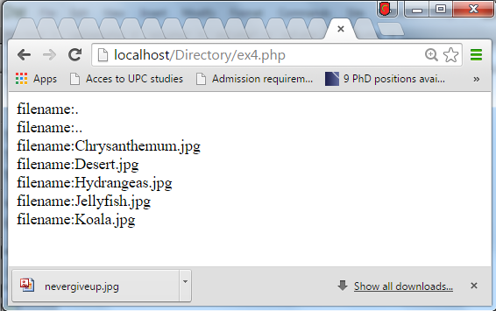
PHP opendir() and closedir() Function
Open a directory, read its contents, then close:
The opendir() function opens a directory handle.
Syntax
opendir(path);
Example: ex4.php
<?php
$dir = "c:wamp/www/File/uploads";
// Open a directory, and read its contents
if (is_dir($dir)){
if ($dh = opendir($dir)){
while (($file = readdir($dh)) !== false){
echo "filename:" . $file . "<br>";
}
closedir($dh);
}
}
?>

Slide 35
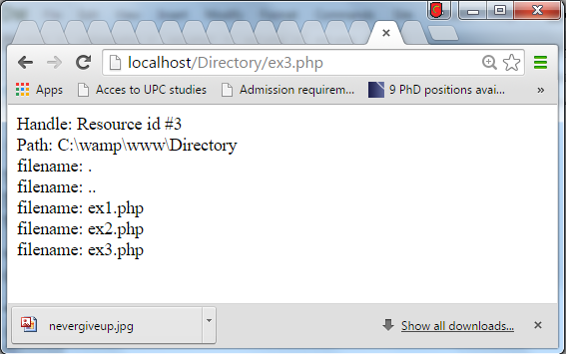
PHP dir() Function
The dir() function returns an instance of the Directory class.
This function is used to read a directory, which includes the following:
The given directory is opened
The two properties handle and path of dir() are available
Both handle and path properties have three methods: read(), rewind(), and close()
Syntax
dir(directory);
Example: ex3.php
Use the dir() function:
<?php
$d = dir(getcwd());
echo "Handle: " . $d->handle . "<br>";
echo "Path: " . $d->path . "<br>";
while (($file = $d->read()) !== false){
echo "filename: " . $file . "<br>";
}
$d->close();
?>

Slide 36
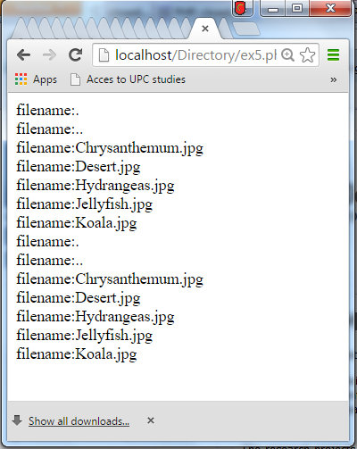
PHP rewinddir() Function
The rewinddir() function resets the directory handle created by opendir().
Syntax
rewinddir(dir_handle);
Example ex5.php
Open a directory, list its files, reset directory handle, list its files once again, then close:
<?php
$dir = "c:wamp/www/File/uploads";
// Open a directory, and read its contents
if (is_dir($dir)){
if ($dh = opendir($dir)){
// List files in uploads directory
while (($file = readdir($dh)) !== false){
echo "filename:" . $file . "<br>";
}
rewinddir();
// List once again files in uploads directory
while (($file = readdir($dh)) !== false){
echo "filename:" . $file . "<br>";
}
closedir($dh); } }
?>

Slide 37
PHP scandir() Function
The scandir() function returns an array of files and directories of the specified directory.
Syntax
scandir(directory,sorting_order,context);
Example
List files and directories inside the images directory:
Ex6.php
<?php
$dir = " c:wamp/www/File/uploads ";
// Sort in ascending order - this is default
$a = scandir($dir);
// Sort in descending order
$b = scandir($dir,1);
print_r($a);
print_r($b);
?>
Result:
Array
(
[0] => .
[1] => ..
[2] => cat.gif
[3] => dog.gif
[4] => horse.gif
[5] => myimages
)
Array
(
[0] => myimages
[1] => horse.gif
[2] => dog.gif
[3] => cat.gif
[4] => ..
[5] => .
)

Slide 38
Question?

